Slide 1
Project Checkpoint
Jaydon Debus and Philipp Kouterguine

Slide 2
Problem Statement
Ecommerce platforms generate millions of customer reviews daily, yet manually analyzing this volume of feedback is infeasible for businesses.
Traditional single-machine tools cannot efficiently process datasets at this scale.
This project leverages Apache Spark on a distributed computing setup to perform sentiment analysis on 14.3 million Amazon Grocery & Gourmet Food reviews
Our project demonstrates technology businesses can use to automatically classify customer sentiment and extract insights at scale.

Slide 3
Dataset Acquisition & Preprocessing
We are utilizing the Amazon Reviews 2023 dataset. Specifically, the "Grocery and Gourmet Food" category, which contains approximately 14.3 million reviews.
We implemented a streaming data approach using the Hugging Face datasets library and API. This allows us to pull data directly into our Spark environment without requiring bucket storage for the raw 5.97 GB JSON file.
The preprocessing pipeline has been implemented in PySpark and includes the following steps:
Filtering: Neutral reviews (3.0-star ratings) are removed to frame the problem as a clear binary classification task.
Label Creation: Star ratings of 4.0 and 5.0 are mapped to a positive sentiment label (1), while ratings of 1.0 and 2.0 are mapped to a negative sentiment label (0).
Text Cleaning: All review text is converted to lowercase and stripped of punctuation using regular expressions to prepare it for tokenization.

Slide 4
Cluster Setup & Configuration
The distributed computing environment has been created on the Google Cloud Platform (GCP). The system utilizes a Dataproc cluster configured specifically to handle the memory demands of the Spark ML pipeline.
The cluster specifications are as follows:
Framework: Managed Apache Spark via GCP Dataproc
Architecture: Single Node (Master acting as worker)
Machine Type: n1-standard-4 (4 vCPUs, 15 GB RAM)
Networking: Cloud NAT Gateway configured to allow external API access for data streaming.
Programming Language: Python
Development Environment: JupyterLab (Via component gateway)
This configuration successfully resolved initial JVM out-of-memory errors initially encountered during early testing. This current setup provides sufficient headroom for the TF-IDF feature extraction process.

Slide 5
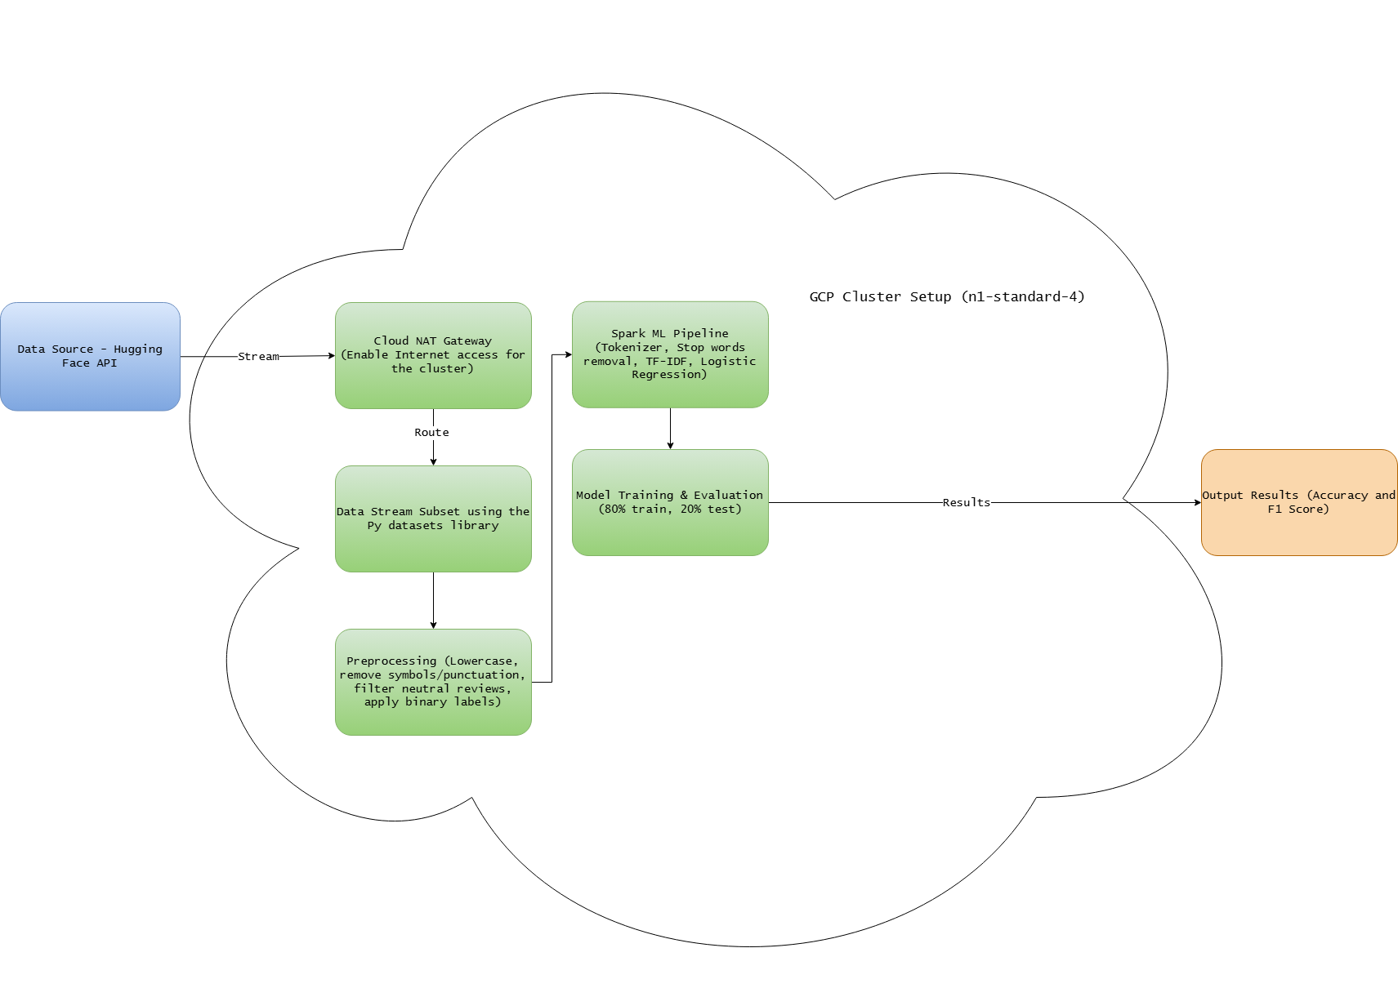
System Architecture

Slide 6
Preliminary Implementation & Results
The machine learning pipeline has been implemented and successfully executed end-to-end on subsets of the data.
The pipeline splits the preprocessed data into an 80% training set and a 20% testing set.
Preliminary experiments have yielded strong initial results. On a test run utilizing 250,000 reviews, the model achieved the following performance metrics:
Test Accuracy: 92.82%
Test F1-Score: 92.04%
The high F1-score confirms that the model is performing well across both positive and negative classes, rather than simply defaulting to the majority class.

Slide 7
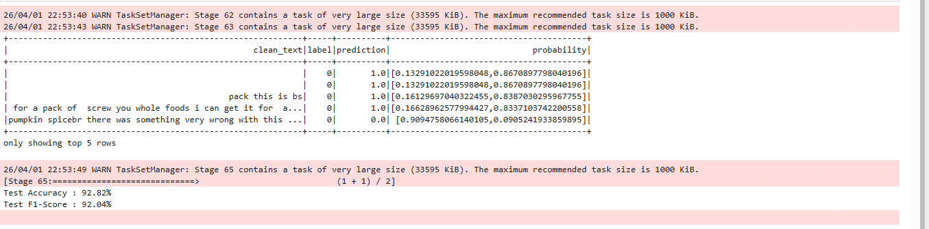
Preliminary Implementation & Results

Slide 8
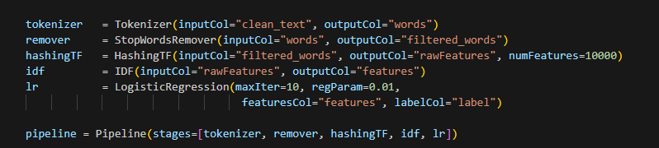
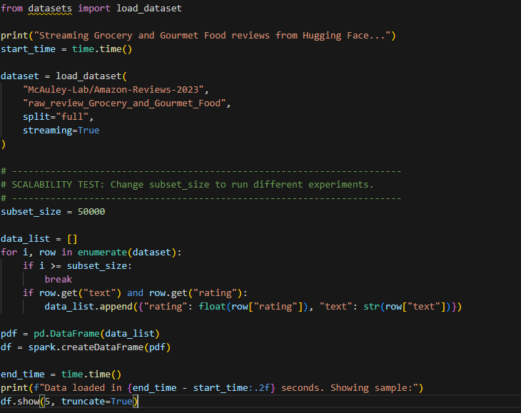
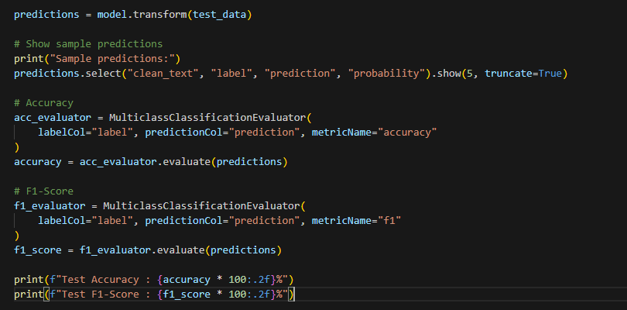
Preliminary Implementation & Results

Slide 9
Next Steps
Scalability Analysis: Completing measurements across increasing various dataset sizes (up to 500,000+ rows).
Interactive Demonstration: We have started to create a real-time prediction function that allows users to input custom review text and receive instant sentiment classification from our trained model .
Literature Review: Reviewing related academic work to frame the final technical report.

